Slide 1
Exploratory Data Analysis of Large-Scale Industry Performance Dataset Using Univariate, Bivariate, and Multivariate Statistical Techniques
NextHikes Solutions Internship Project
By Bindu Kale A

Slide 2
Introduction
Exploratory Data Analysis (EDA) is an analysis approach that identifies general patterns in the data. It is a statistical process used to understand datasets through summary statistics, visualizations, and relationship analysis before predictive modeling or machine learning.
Python libraries I have used here is pandas, numpy, matplotlib, scipy, seaborn which provide powerful tools for data manipulation, statistical analysis, and visualization.
The primary objective of this analysis is to understand the characteristics of companies across different sectors and evaluate factors that influence business performance.
Companies operate in highly competitive environments, understanding the drivers of revenue, profitability, and customer growth is important for business planning. This analysis has helped to uncover how company size, customer base, and market perception impact performance.

Slide 3
Dataset Overview
Before identifying trends, it was important to understand what information was available and whether the dataset was reliable.
The dataset contains 15,000 records and 12 variables, providing a large sample for analysis
I have analyzed a comprehensive dataset of mid-to-large companies across 5 industries, 4 countries, and 3 regions.
Industries: Finance, Technology, Retail, Manufacturing, Healthcare.
Countries: USA, Germany, India, Canada
Regions: North America, Asia, Europe
This dataset also includes numerical, categorical, and date variables representing different aspects of company operations.
Overall, it provides a comprehensive view of company performance across multiple sectors and locations.

Slide 4
Data Quality Assessment
The study involves data preprocessing, descriptive statistical analysis, distribution analysis, outlier detection, correlation analysis, and multivariate comparisons.
Firstly, Data quality checks were performed to ensure reliability and accuracy.
I have cleaned the data, there were no missing values found across any of the variables.
No duplicate records were identified, confirming that each company appears only once.
For easy analysis, I have changed the created date to datetime format and checked for datatypes. I have done standardization of column names.
With all this, the dataset was clean and ready for further analysis without extensive preprocessing.

Slide 5
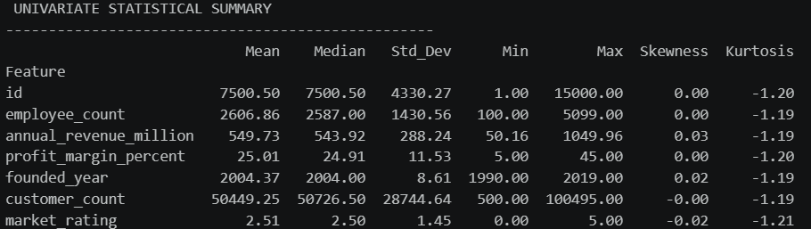
Univariate Analysis
Companies average 2,600 employees, $550M annual revenue, and 25% profit margin, Customer base averages ~50,000 per company
The uniform spread in employee count indicates that companies in this space come in many sizes but operate within a similar operational band.
Profitability is healthy and consistent across the board. The market appears to reward operational efficiency fairly evenly.
All numerical variables show near-zero skewness and kurtosis of roughly -1.20 which shows that the distribution was uniform.

Slide 6
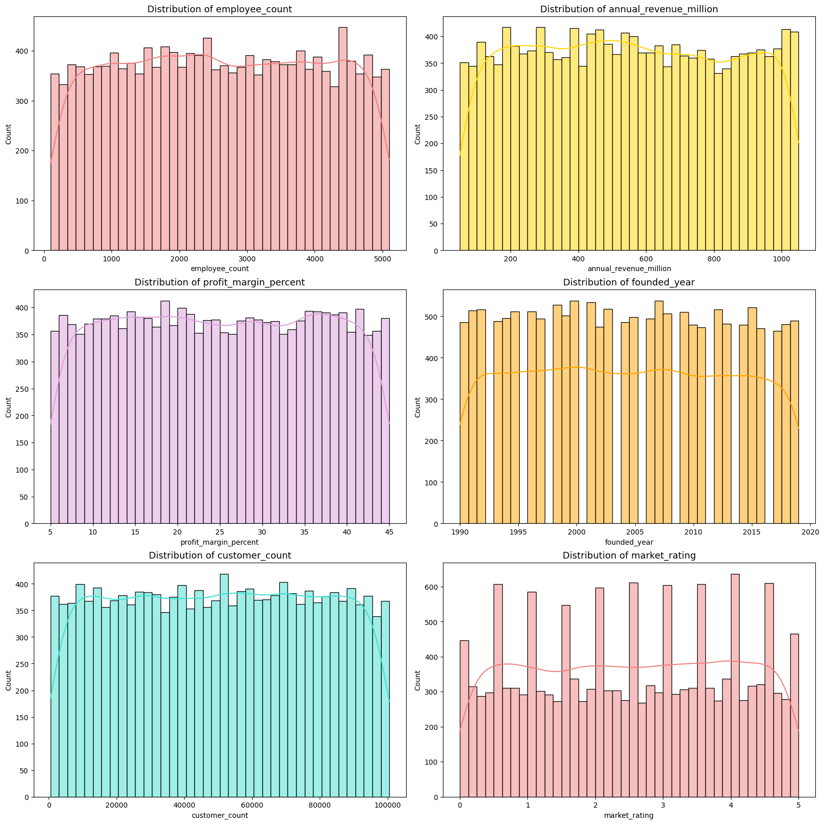
Visualization of Numerical Distribution
The distributions of numerical variables were examined using statistical measures and visualizations.
The data proves that financial success and business size are spread out evenly. This represents medium-to-large enterprises operating at substantial commercial scale.

Slide 7
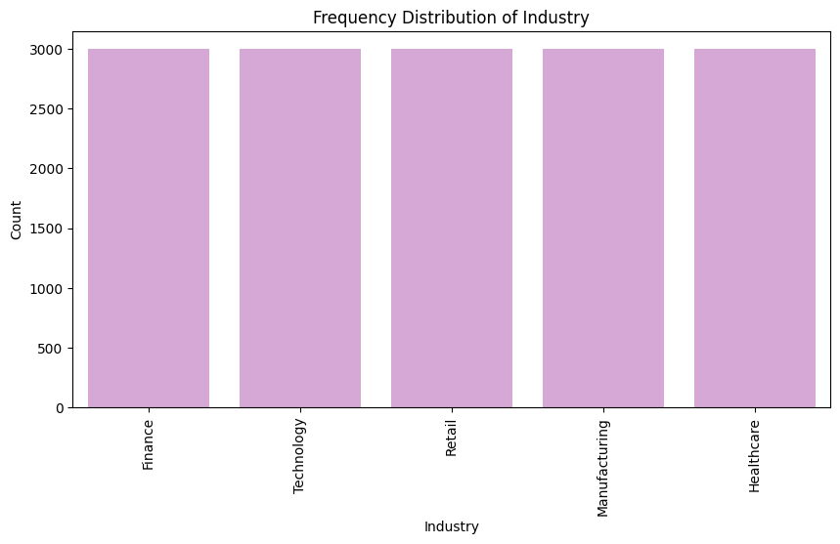
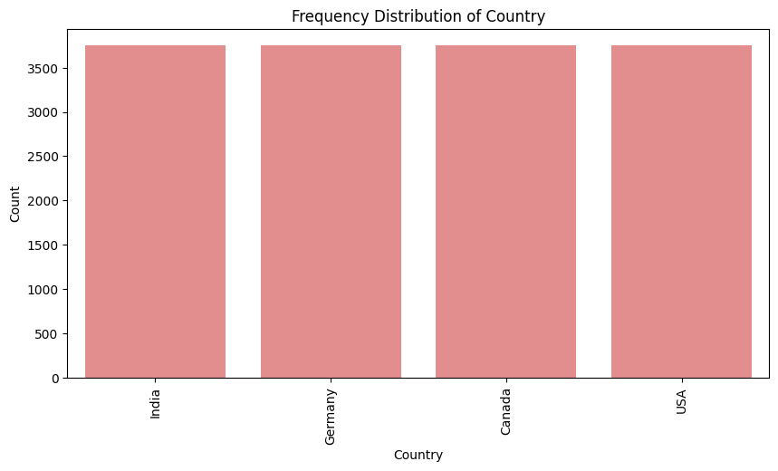
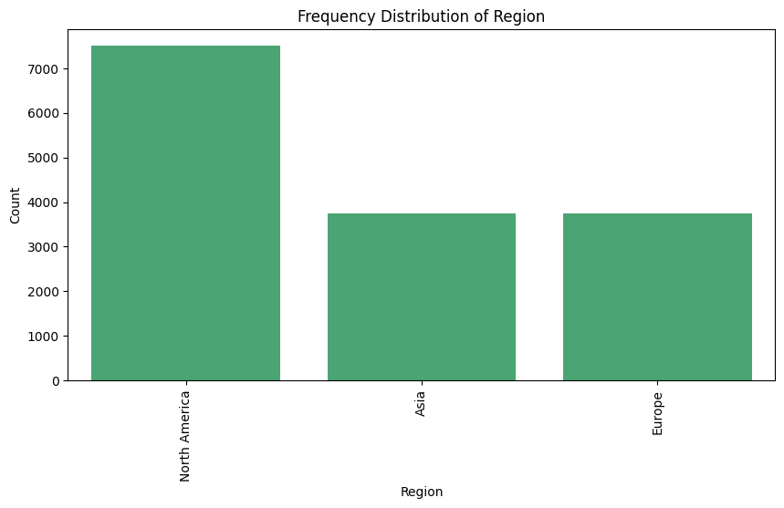
In Frequency distribution, we can see that, the data is perfectly balanced in all three categorical variables, where no single participant, industry, or region holds an unfair advantage, and extreme data distortions are absent.
We can see that all 5 industry contain equal representation with 3000 companies each.
North America accounts for 50% of the dataset, while Asia and Europe each contribute 25%. This imbalance occurs because both USA and Canada fall under North America.
As a result, regional analysis may show stronger influence from North American companies compared to other regions.

Slide 8
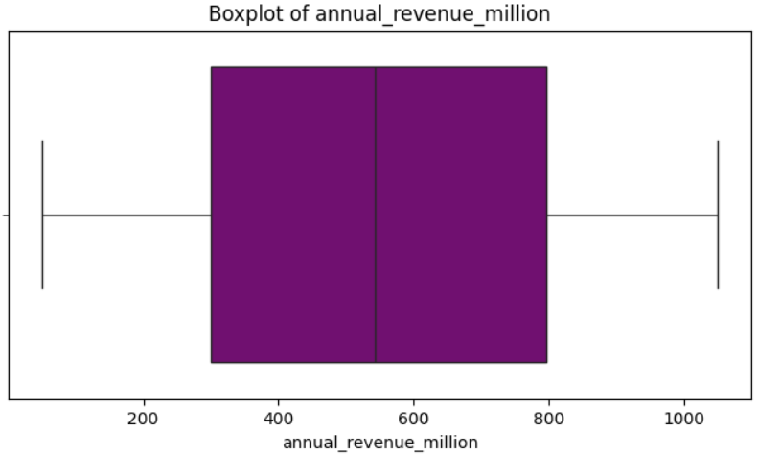
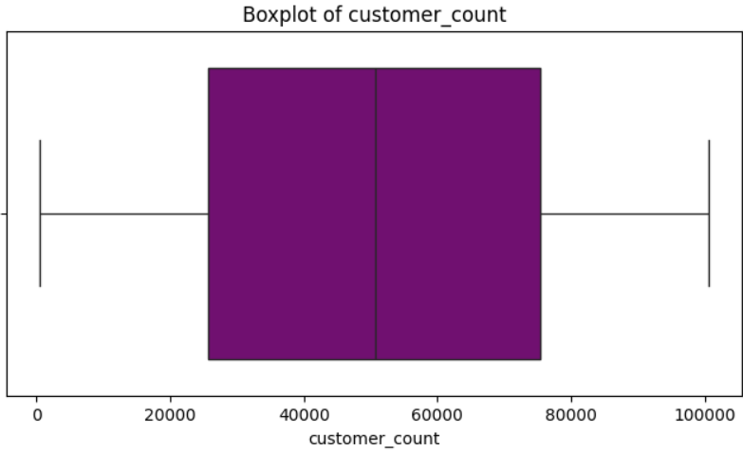
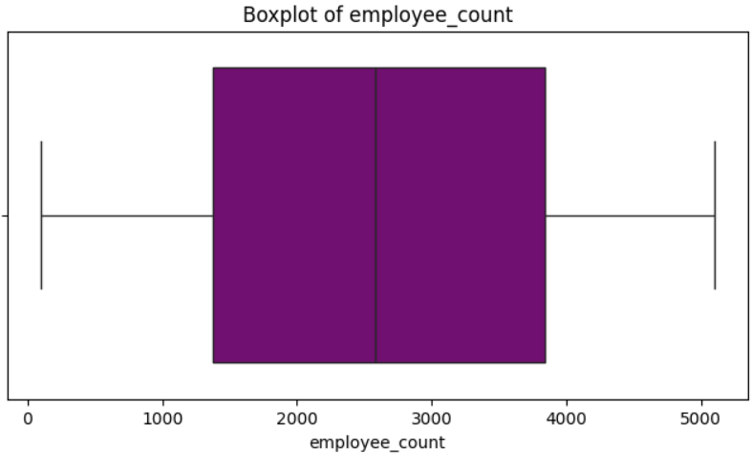
Outliers Detection
Outlier analysis was conducted using boxplots, IQR methods.
Zero outliers detected across all variables (confirmed by IQR and boxplots)
The distributions are remarkably clean and symmetrical.
Extreme values were observed in revenue, employee count, and customer count, they were some of the largest companies in the market.
This reinforces the earlier observation of highly uniform, stable, and consistent data across the entire dataset.

Slide 9
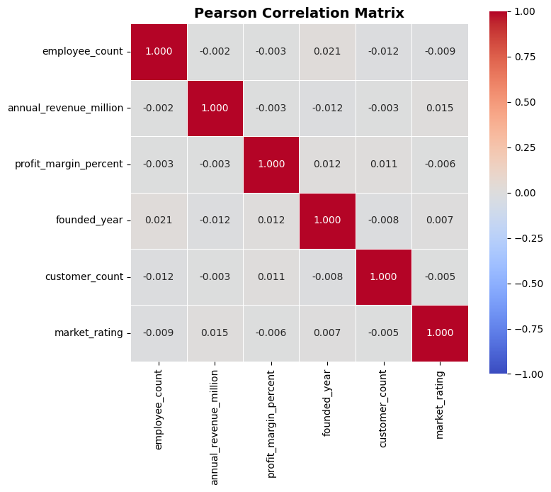
Bivariate Analysis
A correlation matrix and heat map were used to identify
relationships among numerical variables.
The correlation matrix reveals extremely weak or
no linear relationships between all key variables.
Company size (employees) has almost no impact
on revenue, profit, or customer count
No meaningful relationship between market rating
and profitability
Age of company (founded year) shows negligible
influence on performance
Employee count has almost zero correlation with revenue
(-0.002), profit margin (-0.003), customer count (-0.012), or market rating (-0.009).
No severe multicollinearity was detected among the variables.

Slide 10
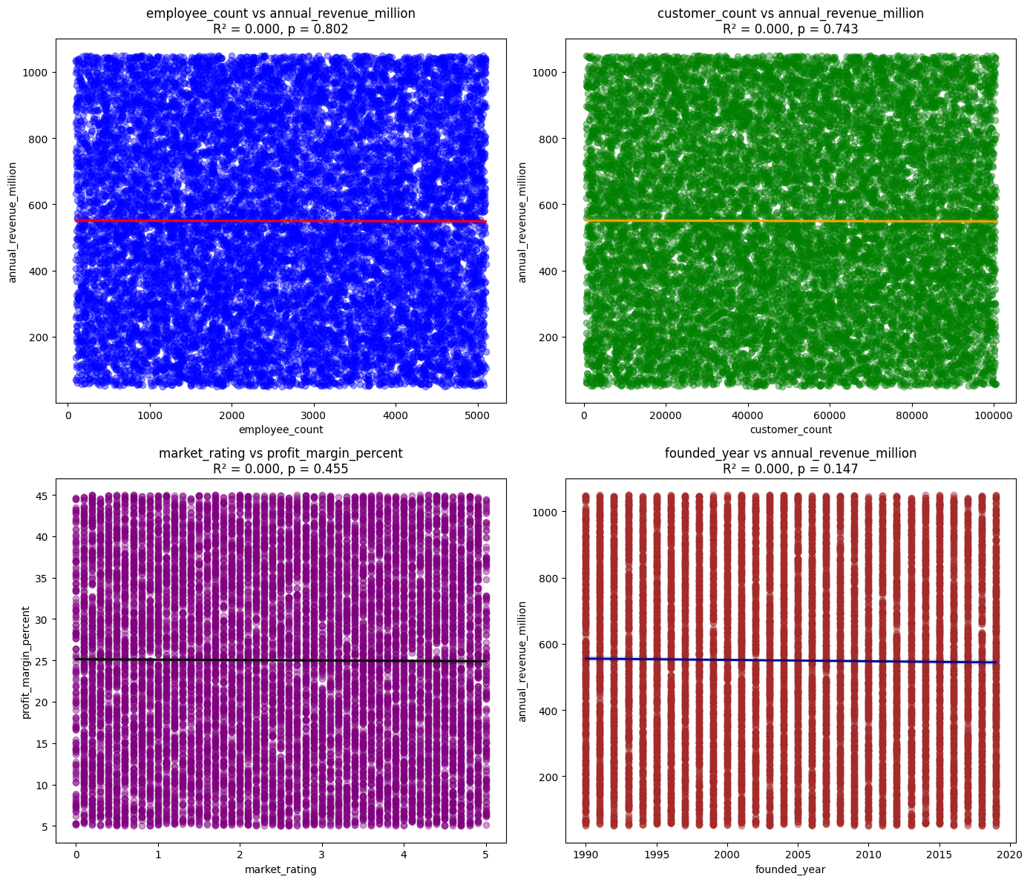
The scatter plots and regression results confirm
complete absence of meaningful relationships
across all variable pairs.
Random scatter of all the mentioned graphs
shows R² ≈ 0.000 and high p-values (>0.14),
indicating no linear patterns or predictive power.
This shows there are no clear drivers of success
in this ecosystem.
The scatter plots and regression results confirm
complete absence of meaningful relationships
across all variable pairs and they operate entirely
independently.

Slide 11
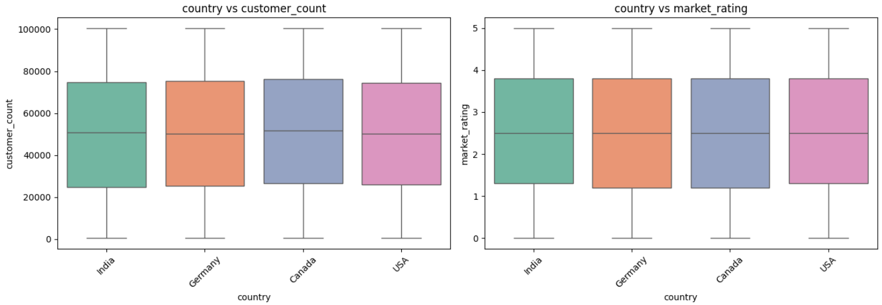
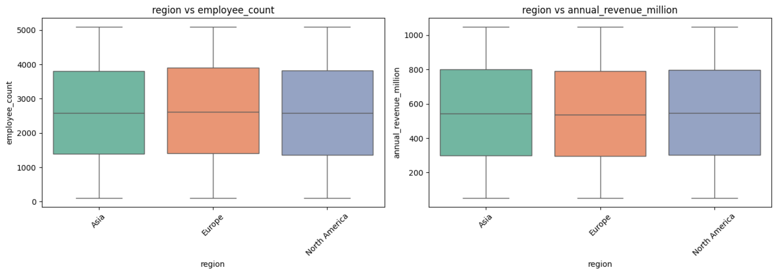
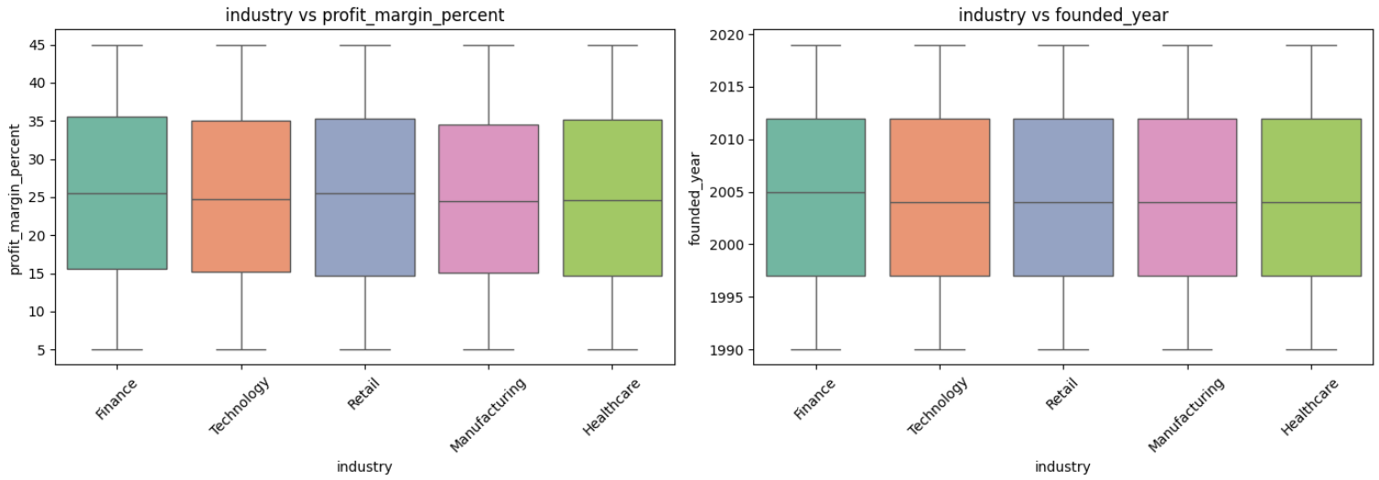
Bivariate Outliers- Box Plots
Boxplots are very important in this EDA because they
help us compare distributions across categorical
groups (Industry, Country, Region) against
numerical variables, going beyond simple averages.
We can visually confirm there are no significant
outliers within any industry/country/region,
maintaining the "clean & balanced" story.
Hence, proving distributions are almost identical
across groups.

Slide 12
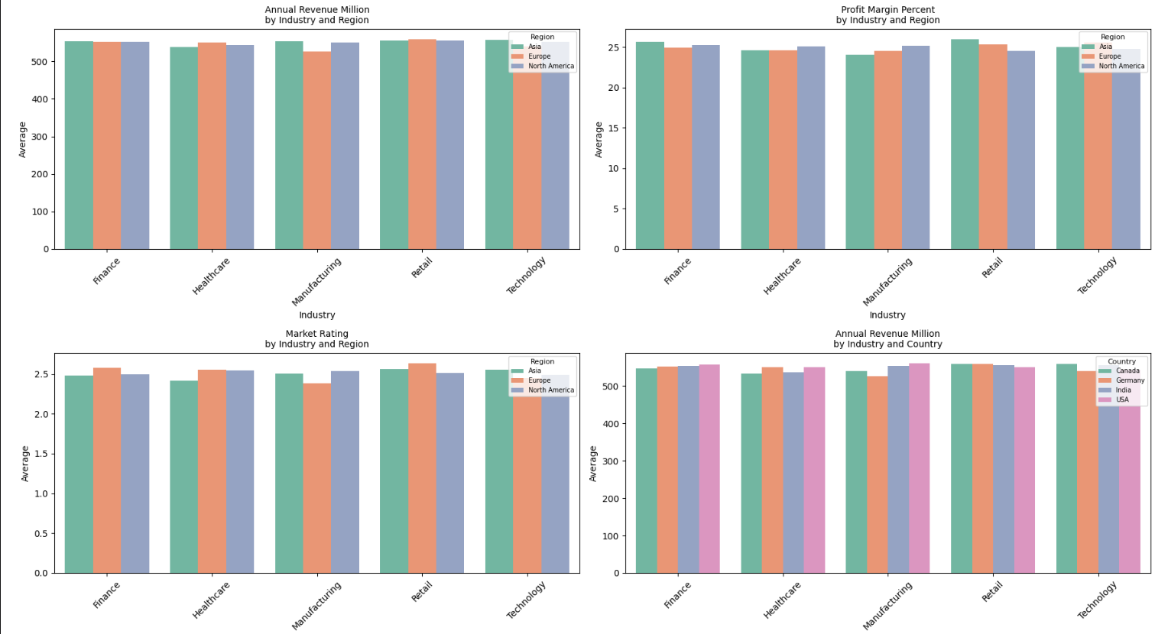
Multivariate & Segment Analysis
Multivariate analysis examined how multiple variables interact together.
Even when combining factors, differences remain extremely small and insignificant.
In Industry variable, there is near identical performance across all sectors.
Average revenue, profit margin, employee count, and customer base stay very consistent across all combinations.
No industry performs dramatically better in any specific region or country.

Slide 13
Countries & Regions have very consistent results, no country or region significantly outperforms others.
When examining combinations of variables like Industry × Region, Country × Industry, Region × Market Rating, etc., differences remain extremely small and insignificant.
Average revenue stays tightly clustered (540M–560M) across all industries and regions.
Employee count, customer count (~50K), and profit margin (~25%) show almost identical patterns regardless of industry, country, or region.
No meaningful interactions emerge e.g., higher market ratings do not consistently deliver better margins, and no industry dominates in any geography.

Slide 14
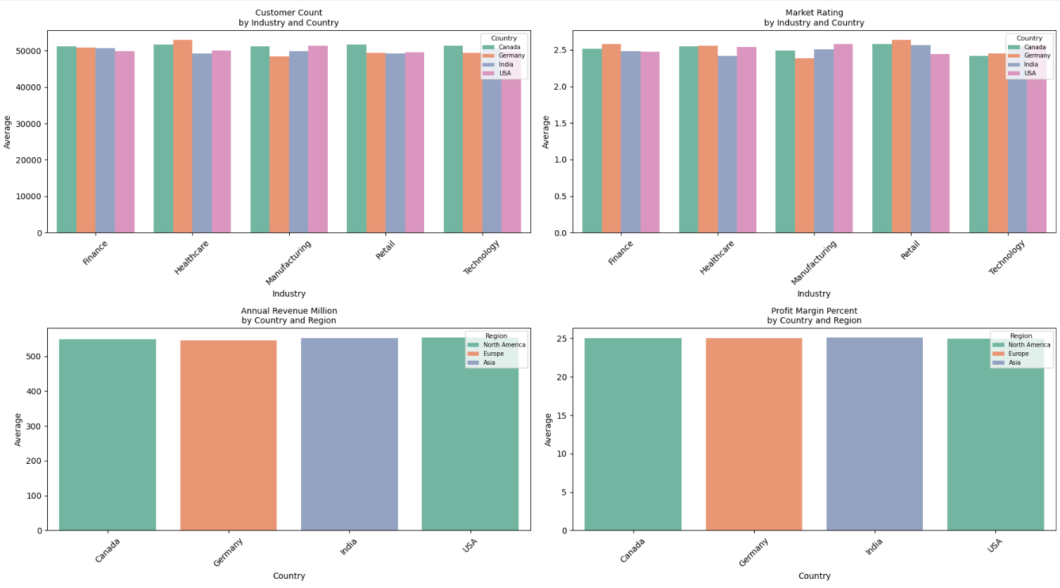

Slide 15
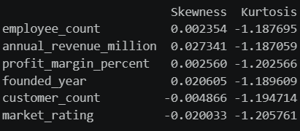
Skewness and Kurtosis Interpretation:
All variables have skewness values very close to 0 (between -0.02 and 0.03), indicating that the distributions are approximately symmetric with no significant left or right skew.
The kurtosis values are all around -1.2, which suggests platykurtic distributions. This means the distributions are flatter than a normal distribution and have lighter tails.
We can conclude that the skewness and kurtosis analysis suggests that the business metrics are generally well-balanced, symmetric, and free from extreme observations.

Slide 16
Overall Conclusion
The analysis successfully explored company performance across industries, countries, and regions.
The industry represents a mature, fair, and highly competitive ecosystem.
Success is evenly distributed and not driven by company size, industry, geography, or age.
Market perception played an important role in profitability, while company age showed limited influence.
This is an exceptionally clean dataset with high stability and low variability.
These insights establish clear benchmarks and provide a factual foundation for our upcoming business decisions.

Slide 17
Business Implications
The analysis indicates that business success is driven more by operational scale, customer reach, and market perception than by company age.
The dataset portrays a diverse and competitive business environment where companies vary significantly in workforce size, customer reach, profitability, and revenue generation.
Despite these differences, the distributions remain relatively balanced, indicating that success is not concentrated among a few organizations.
Companies seeking growth should focus on expanding their customer base, improving operational efficiency, and strengthening market reputation, as these factors are likely to have the greatest impact on long-term business performance.

Slide 18
THANK YOU

